Slide 1

AMAZON SALES ANALYSIS
Gurram Santosh Kumar
08/10/2024

Slide 2

Agenda
Introduction
Problem Statement
Data Description
KPI’S and Visualizations
Reports

Slide 3
Introduction:
Amazon is an e-commerce platform that sells a wide range of products and services online. Here's some information about Amazon's e-commerce business:
Founding: Jeff Bezos founded Amazon in 1994 as "Calabar Inc.", which he later renamed to "Amazon".
Early focus: Amazon began as an online bookstore, but quickly expanded to include other products like electronics, apparel, and groceries.
Third-party sellers: Amazon Marketplace allows third-party sellers to sell their products on Amazon's site. This gives Amazon access to more products without having to invest in inventory.
Customer loyalty programs: Amazon Prime offers customer loyalty programs, free shipping, and other benefits.
Website traffic: In 2022, Amazon.com had more than 2 billion monthly visitors.
Country-specific websites: Amazon has country-specific websites, such as amazon.com for the U.S. and amazon.co.uk for the U.K.

Slide 4
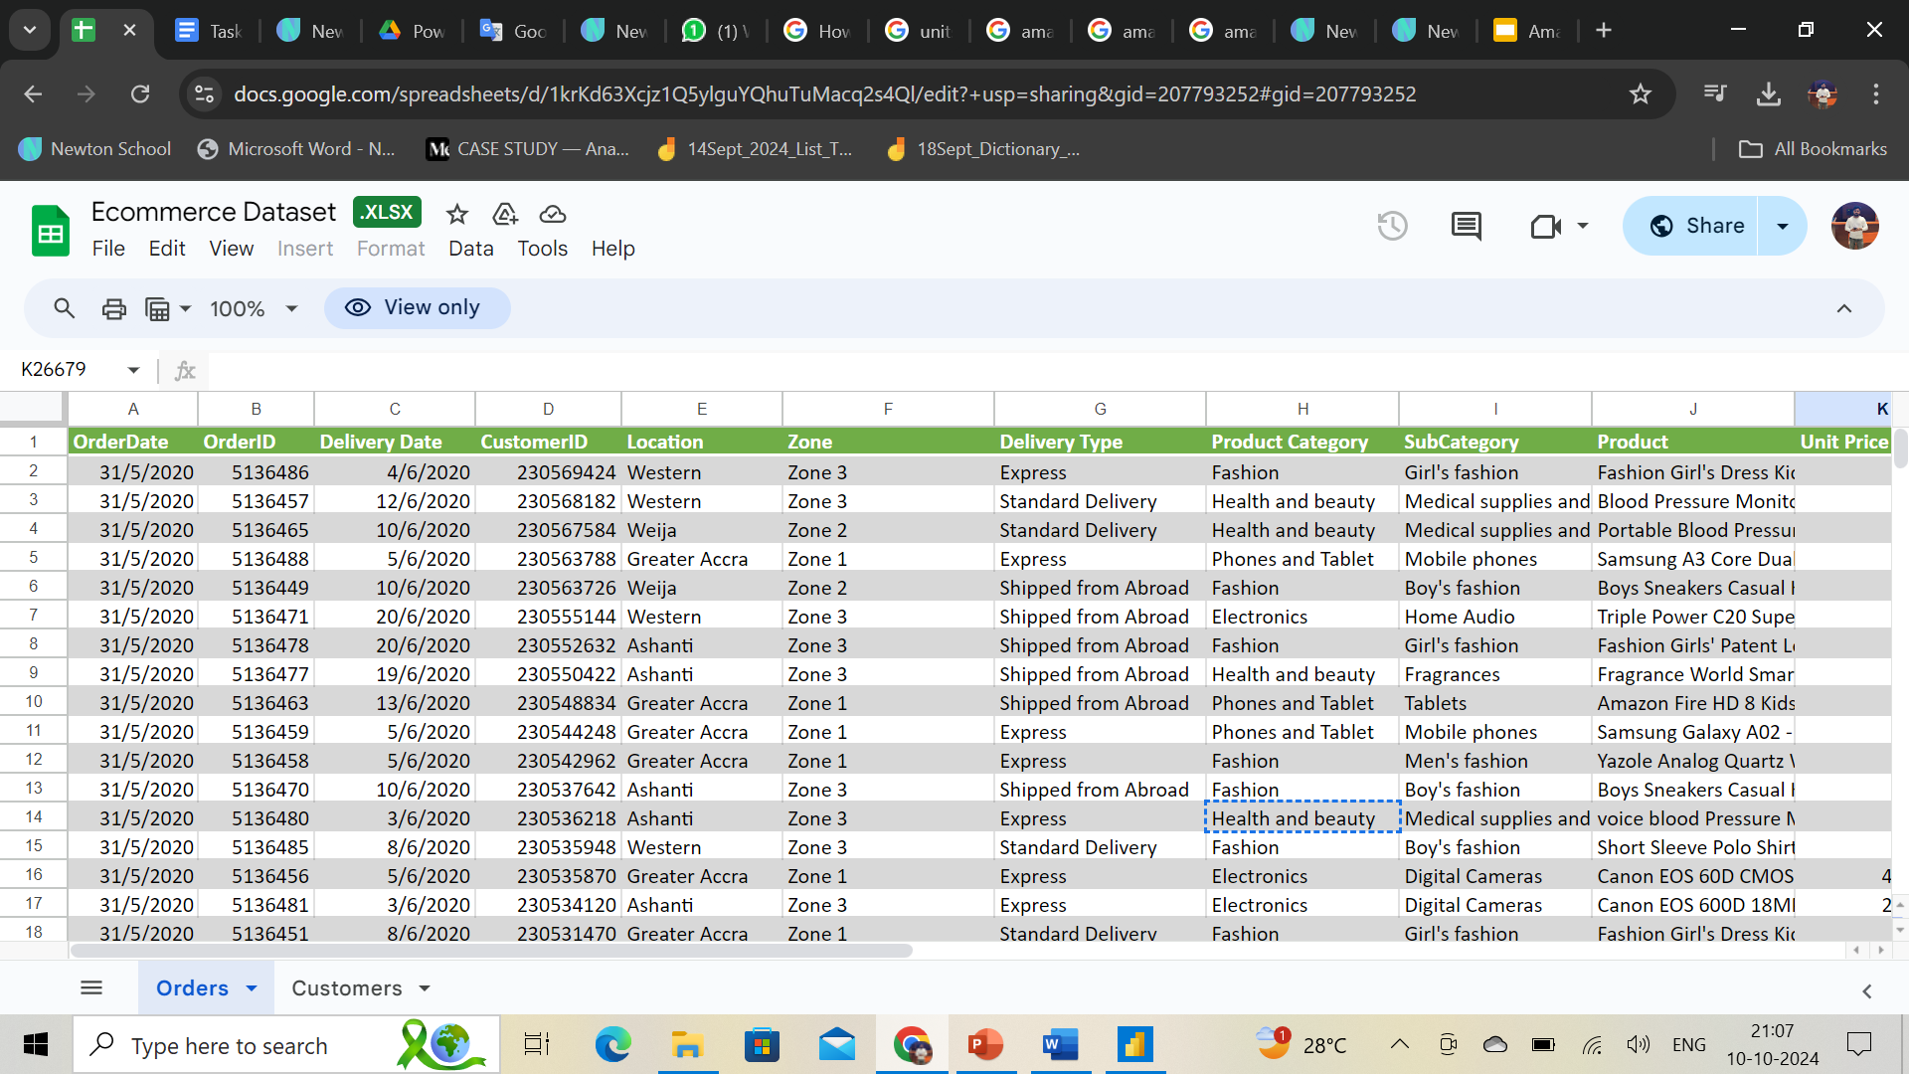
Problem statement:
You are working as a business analyst at Amazon, a company currently performing well. The stakeholders wish to maintain this level of performance and seek improvement. For this purpose, they want to devise new strategies. You are part of a team exploring new ways to benefit customers, such as offering more discounts and Prime membership perks. Could you suggest additional methods to identify and reward customers and enhance their shopping experience?

Slide 5
The image above displays details about E-Commerce data, including:
Data Description:
OrderDate: The date when the order was placed.
OrderID: A unique identifier for each order.
Delivery Date: The date when the order is scheduled to be delivered.
CustomerID: A unique identifier for each customer.
Customer Age: The age of the customer.
Customer Gender: The gender of the customer (M for male, F for female).
Location: The geographical area where the customer is located.
Zone: Specific zone within the location for delivery purposes.
Delivery Type: The method by which the order is delivered (e.g., Express, Standard).

Slide 6
The image above displays details about E-Commerce data, including: (Cont..)
SubCategory: A more specific classification within the product category.
Product: The name or description of the product ordered.
Unit Price: The price per unit of the product.
Shipping Fee: The fee charged for shipping the product.
Order Quantity: The quantity of the product ordered.
Sale Price: The total sale price of the order.
Status: Current status of the order (e.g., Delivered, Returned).
Reason: The reason for the return or an empty field if delivered.
Rating: Customer rating for the order on a scale (e.g., 1 to 5).
Use this Link for copying and then manipulating the dataset.

Slide 7
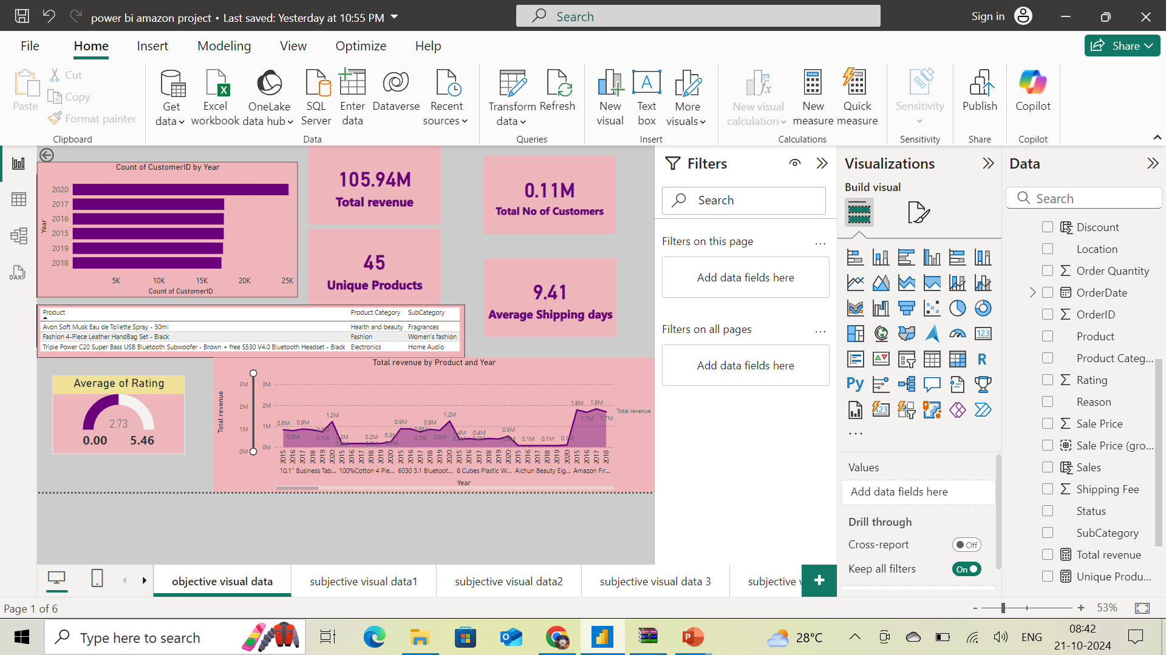

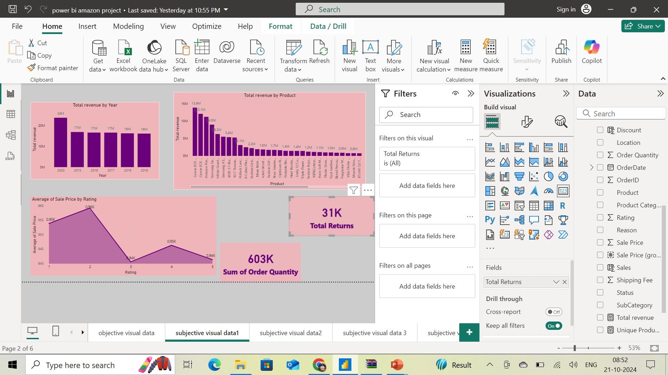
KEY PERFORMING INDICATORS:

Slide 8
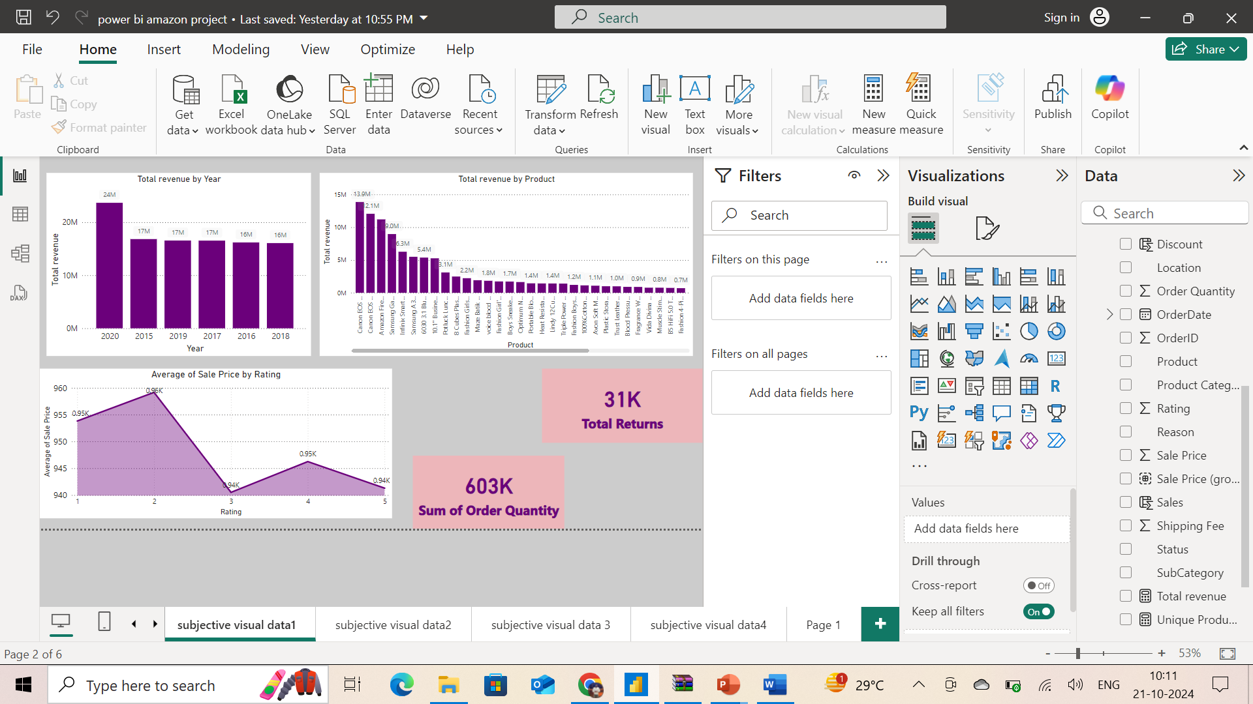
Revenue Distribution Analysis:
With revenue distribution, we can understand which product contributing more to the revenue and also in which year revenue generated more.
Insights:
Revenue generated in the year 2020 is more compared to previous years.
Top revenue generated product is Canon EOS 600D 18MP DSLR Camera- Black with 13.9M sales.

Slide 9
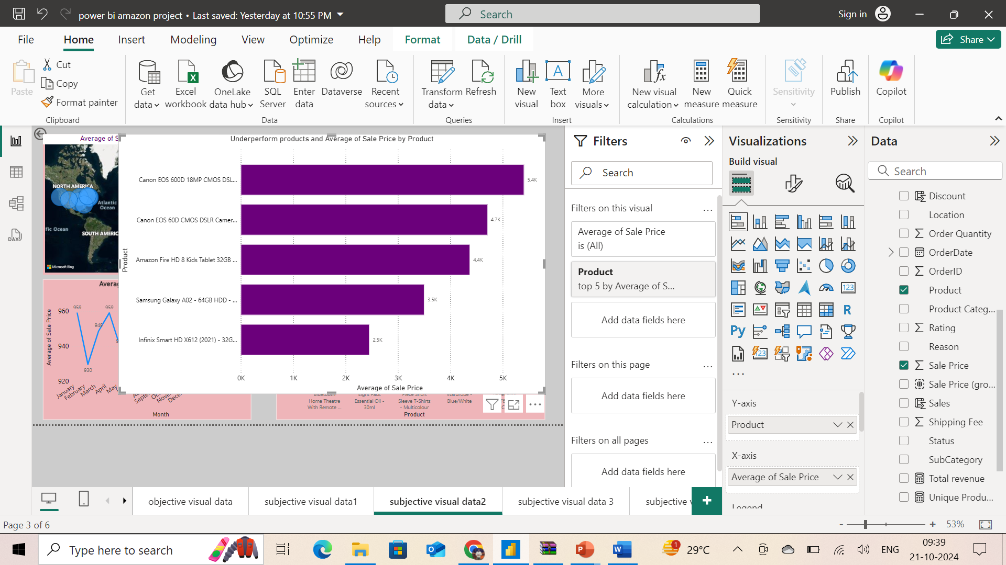
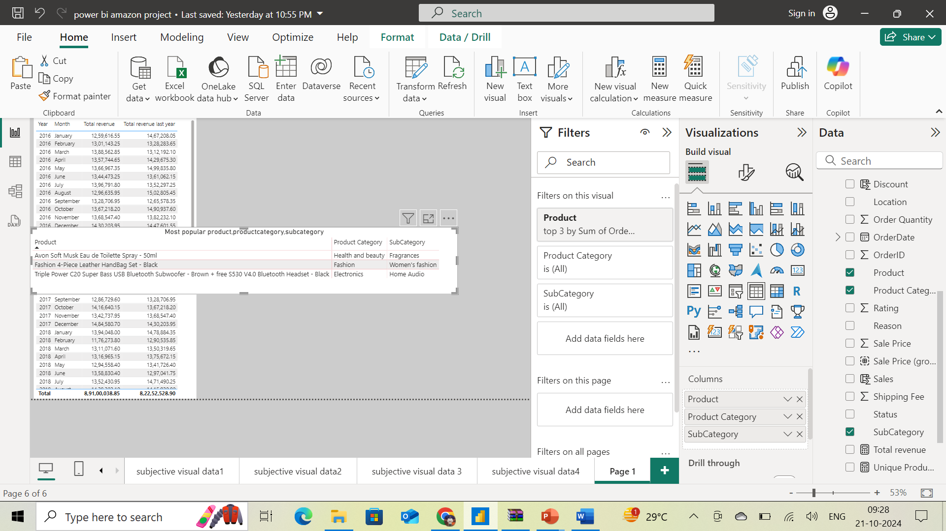
Product Analysis:
In the product analysis, we can see the most popular products and underperforming products.
Insights:
We can see A clear distinction between the most popular, enjoying customer preference with high sales, and the underperforming products, indicating areas that may need targeted marketing efforts to enhance their overall sales.

Slide 10
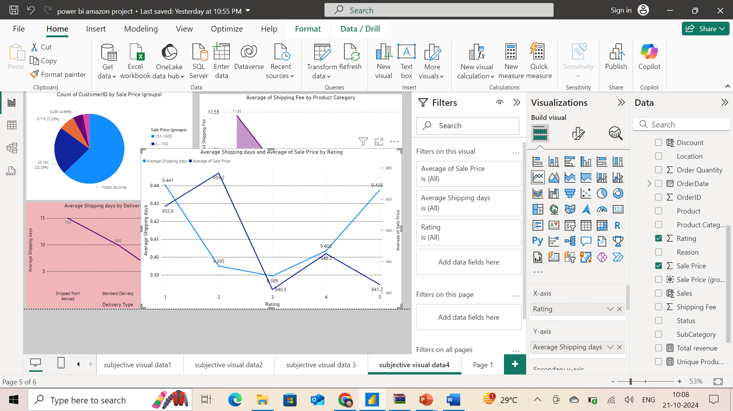
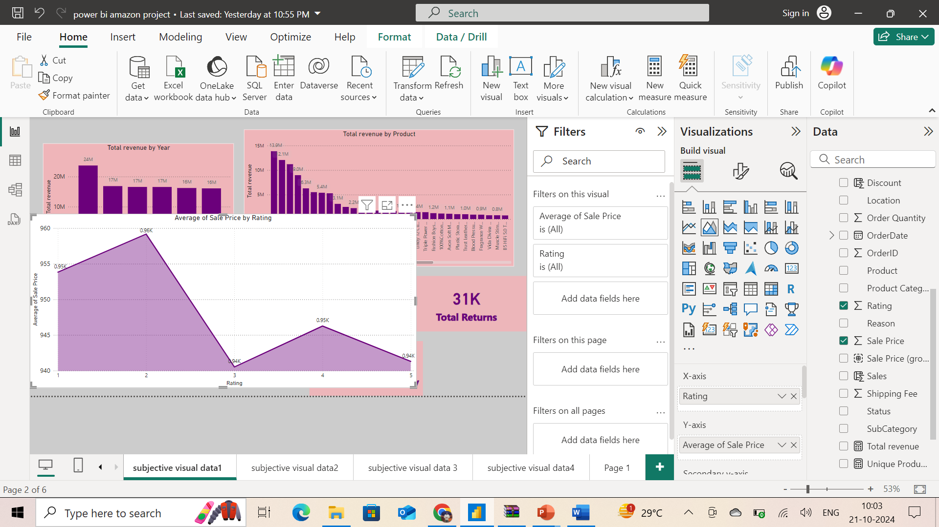
Customer Satisfaction Analysis:
Customer satisfaction will help to understand how they are interested in the platform and how happy they are with shopping experience.
Insights:
Average rating given by customers is 2.73, which is above average.
Customers gave 4 & 5 rating for low unit price products
With less Delivery time, the ratings are very good compared to high delivery time

Slide 11
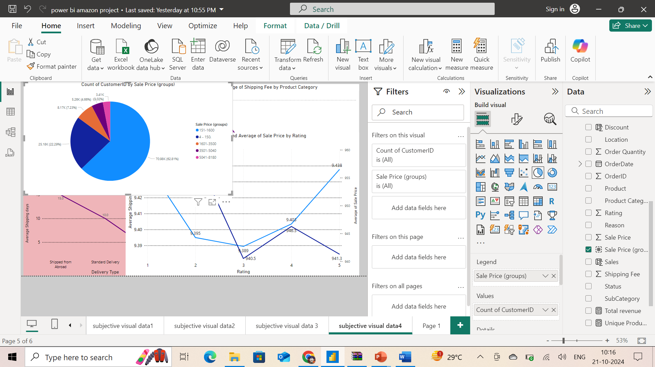
Customer Loyalty Program :
Every company go for customer loyalty program to encourage customers engaging them to purchase more.
Insights:
Grouping the customers by their spending value, 85.21% customers spend low compared to others.

Slide 12
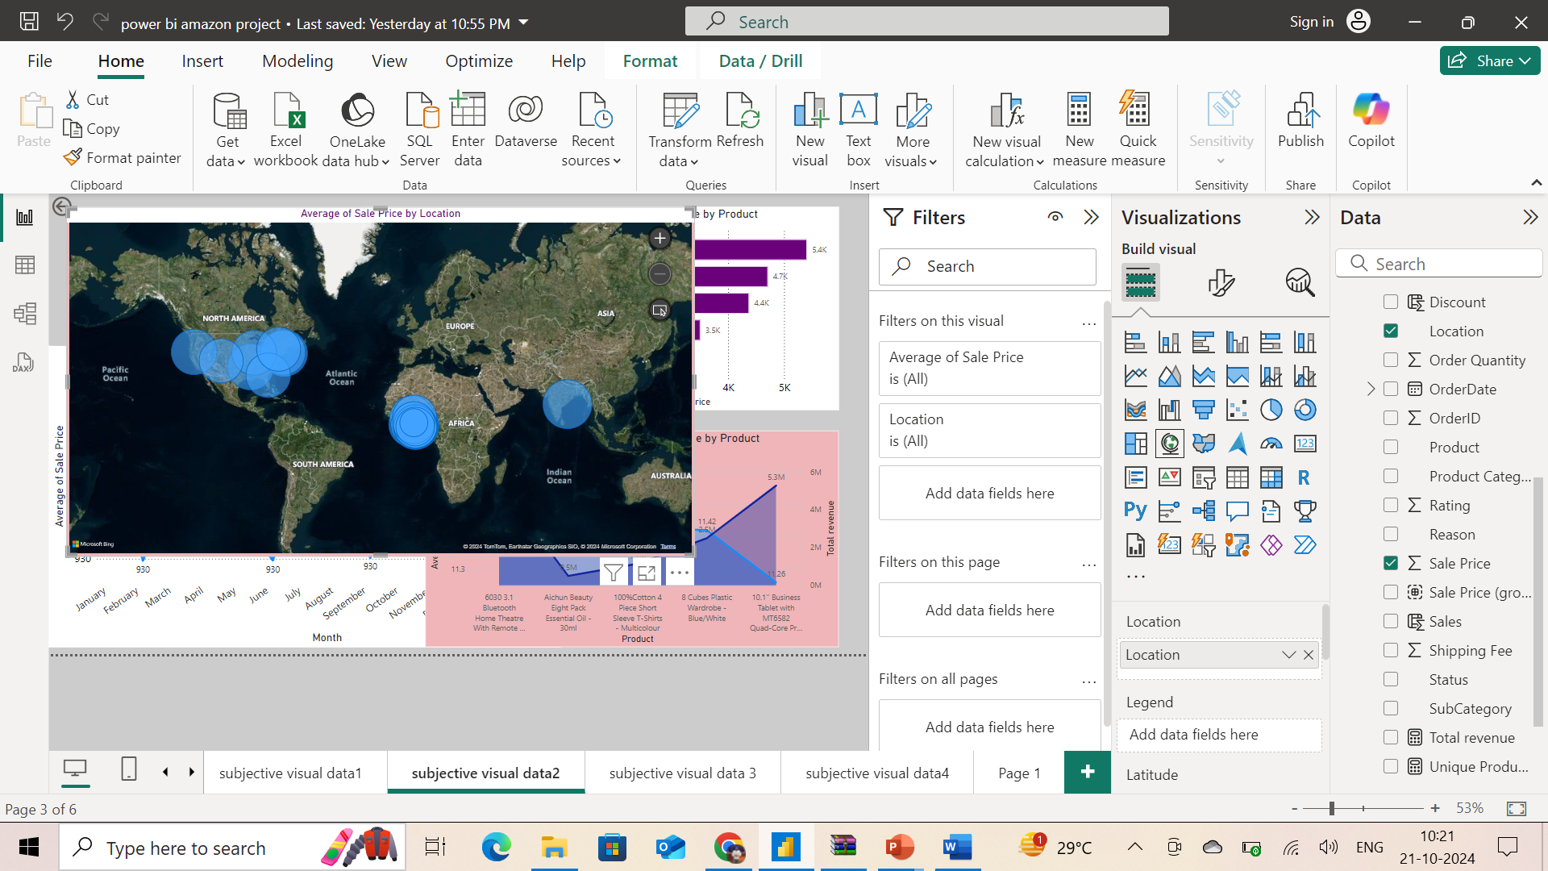
Geographical Analysis :
Geographic analysis will help to devise target marketing and distribution strategies.
Insights:
North-America and African-regions are contributing more to revenue.
South America is the least revenue contributing region.

Slide 13
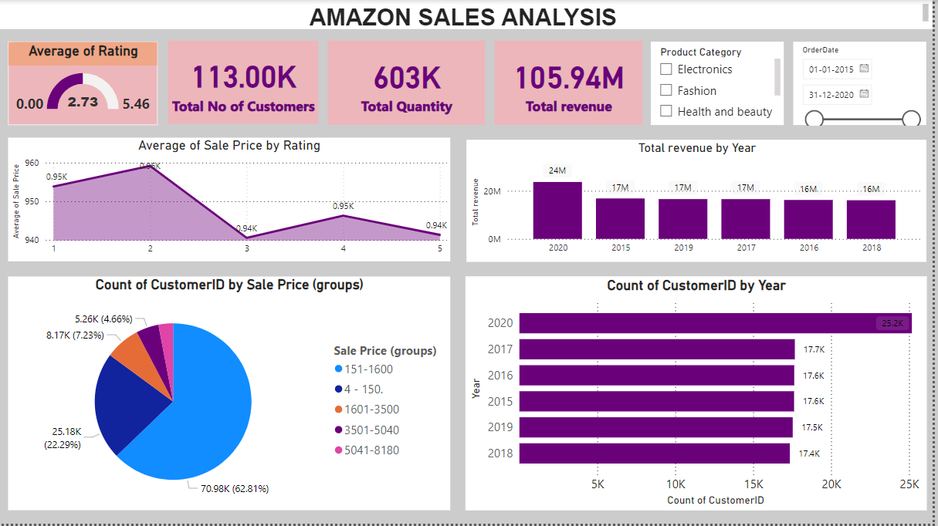
Main Tab
Reports:

Slide 14
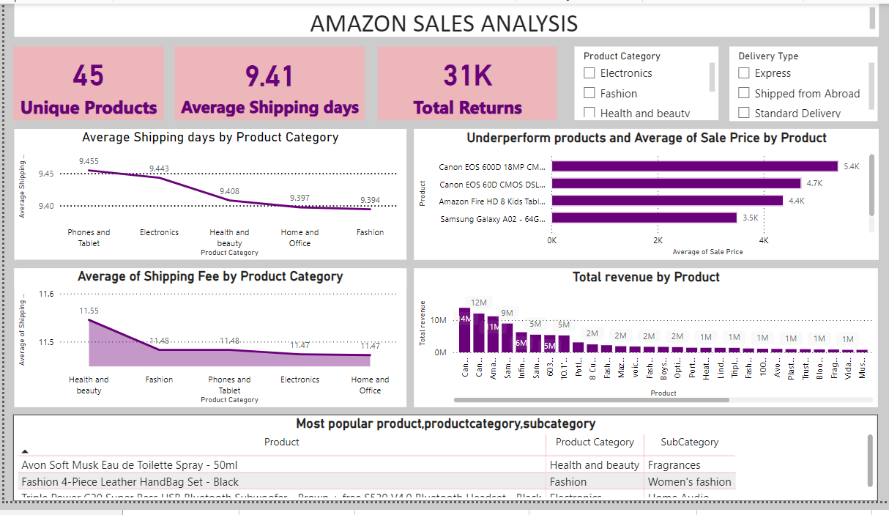
Product Tab

Slide 15
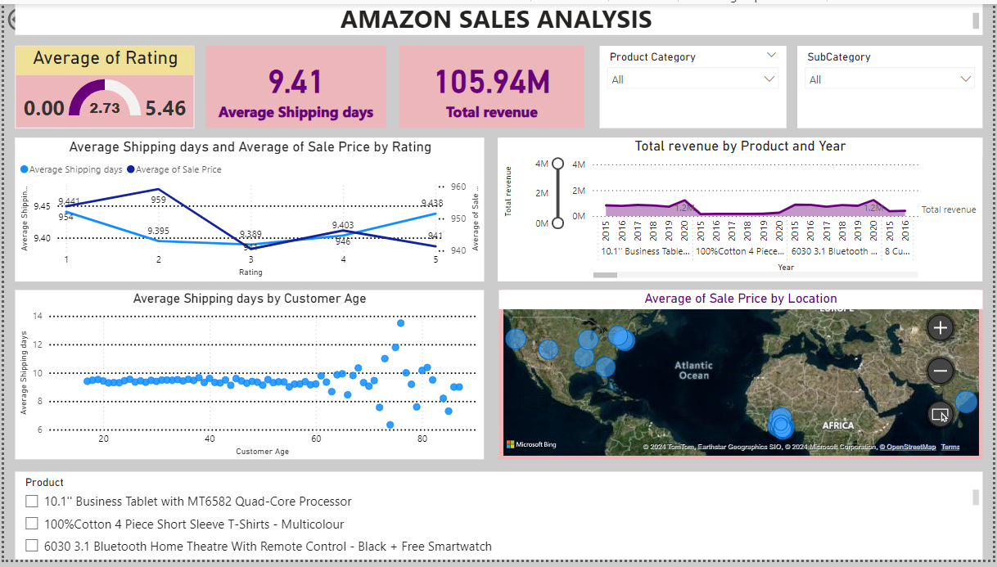
Individual product Tab

Slide 16
References :
Mentor sessions by Shamal Deshmukh and Kumar Harsh.
Sample project by newton’s school.
Collecting some inputs through online-sites like YouTube and Google.
Thank you ….

